Slide 1

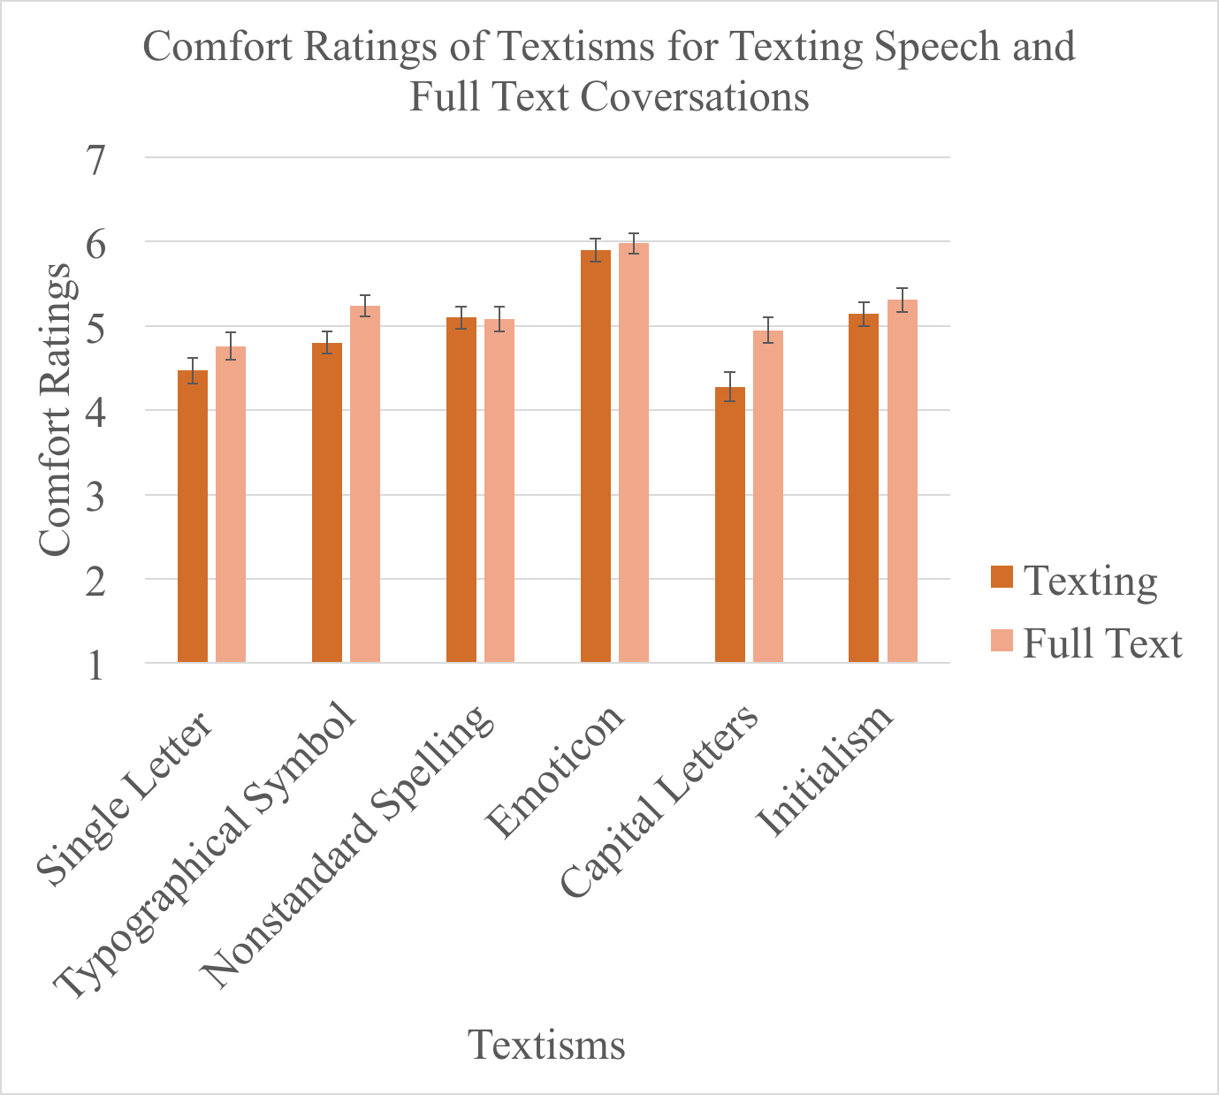
“Textisms”: The Comfort of the Recipient
Flora-Jean Forbes, Erin M. Buchanan, & Melissa Fallone
Ψ
Department
of Psychology
ABSTRACT
This study sought to examine whether certain “textisms” provoke an uncomfortable response for the receiver and if so, to target which specific textisms trigger that response. Participants (N =111) were randomly assigned to either a prompt suggesting that the participants was having a texting conversation with a close friend, or that they were just having a conversation with a close friend, and then provided 18 statements for the participant to read and then asked to rate their levels of comfort. Specifically, for the typographical symbol and capital letter textisms, the participants indicated higher levels of comfort in the full text conversations. In other words, when the content of the conversation is controlled, the presence of these specific textisms decreases comfort ratings of the participant. These findings indicate the significant impact that textisms can have on interpersonal communication.
METHOD
Participants
Participants (N =111) were recruited from the undergraduate participant pool of Introductory Psychology students at Missouri State University.
Materials and Procedure
There were two versions of a questionnaire provided to each participant. Each questionnaire consisted of 18 statements for the participant to read. For each one, the participant indicated on a 7 point Likert scale from 1 extremely uncomfortable to 7 extremely comfortable how they would feel receiving that statement, however the presentation of each statement varied between the questionnaires.
Group 1 (N = 56): (Texting Conversation Prompt): Participants were told to imagine that they having a texting conversation with a close friend and then received statements including textisms.
Group 2 (N = 55): (Fully Written Conversation Prompt): Participants were told to imagine that that they were having a conversation with a close friend and then received statements written out fully.
RESULTS
A 2X6 mixed-design ANOVA with conversation type (text, full) as a between subjects factor and type of texting cue (single letter, symbol, nonstandard spelling, emoticon, capital letters, and initialisms) as the within subjects factor.
The main effect of conversation type appeared to be non-significant, F(1,109) = 2.634, p = .107, η_{p}² = .024.
A main effect was found for type of texting cue, F(5, 545) = 59.783, p< .001, η_{p}²= .354.
This effect was qualified by an interaction between conversation type and texting cue, F (5, 454) = 3.945, p= .002, η_{p}² = .035.
Capital letters presented a significant difference between the scores for full (M = 4.946, SD = 1.087) and texting conversation (M = 4.277, SD = 1.300) conditions; t(109)= -2.937, p = .004, d = 0.56.
There was also a significant difference for typographical symbols for for full (M = 5.244, SD = 0.961) and texting conversation (M = 4.796, SD = 1.004) conditions; t(109)= -2.396, p = .018, d = 0.46.
Figure 1. Means of comfort ratings for textisms across texting speech and full text conversations with standard error as error bars.
DISCUSSION
Our hypothesis was partially supported by the significant difference found between the full conversation and texting conversation for capital letters and the typographical symbols.
Participants reported more negative comfort responses when typographical symbols were used in texting conversation as compared to the responses for the full conversation condition, and also for the typographical symbols when used the texting conversation than the response in the full conversation condition.
From these results, appears that the usage of the “positive” textisms did not do much to impact comfort levels in any significant way but the use of the textisms with the negative connotation can significantly decrease the comfort of the recipient.
Limitations
The conversation response sections were created specifically for this study and some of the textisms were presented in unequal numbers.
The participant sample is primarily traditional university undergraduates, so the results would potentially differ with a more diverse sample.
Future Research
For future replications, it would be important to make sure that the number of textisms are represented equally.
Future research may want to investigate differences in the comfort ratings due to textisms across varying age populations.
INTRODUCTION
Background Literature
Survey data (O’Grady, 2012) found that on average 6 billion SMS messages were sent each day in the United States. Palasick (2014) compiled a literature review describing how text language was forced to evolve from common language due to constraints on characters in written text. Due to these constraints, common textism developed and became a common part of electronic communication.
David Crystal (2008) defines a textism as “an abbreviated word form that is distinctive in texting, such as c for see, txt for text, jk for just kidding, and 2day for today” (p. 187). Due to the significance of these textisms, Crystal (2008) created a list of the most common textisms across various languages in order to demonstrate the different subtypes (i.e. emoticons, abbreviations).
Reid and Reid (2007) conducted an experiment to determine the impact of social anxiety on the preferred methods of communication of participants. Ultimately, they discovered that anxious participants favored texting as a way to communicate emotions and have intimacy with others.
REFERENCES
Crystal, D. (2008). Txting: The gr8 db8. New York, NY: Oxford University Press.
O’Grady, M. (2012, June 19). SMS Usage Remains Strong In The US: 6 Billion SMS Messages Are Sent Each Day. Retrieved from http://blogs.forrester.com/michael_ogrady /12-06-19 sms_usage_remains_strong_in_the_us_6_billion_sms_messages_are_sent_each_day
Palasick, K.E. (2014). LOL MY THESIS: An Exploration of the Written and Oral Linguistic Effects of Text Messaging (Bachelor thesis). Retrieved from: http://digitalwindow.vassar.edu/senior_capstone/360
Reid, F. M., & Reid, D. J. (2010). The expressive and conversational affordances of mobile messaging. Behaviour & Information Technology, 29(1), 3-22.doi:10.1080/01449290701497079
CONTACT INFORMATION
Flora314@live.missouristate.edu
ErinBuchanan@missouristate.edu
Mfallone@Missouristate.edu

